Slide 1



Wines From Around The World
Team 3: Jessica, Chris MCGee, Anthony

Slide 2
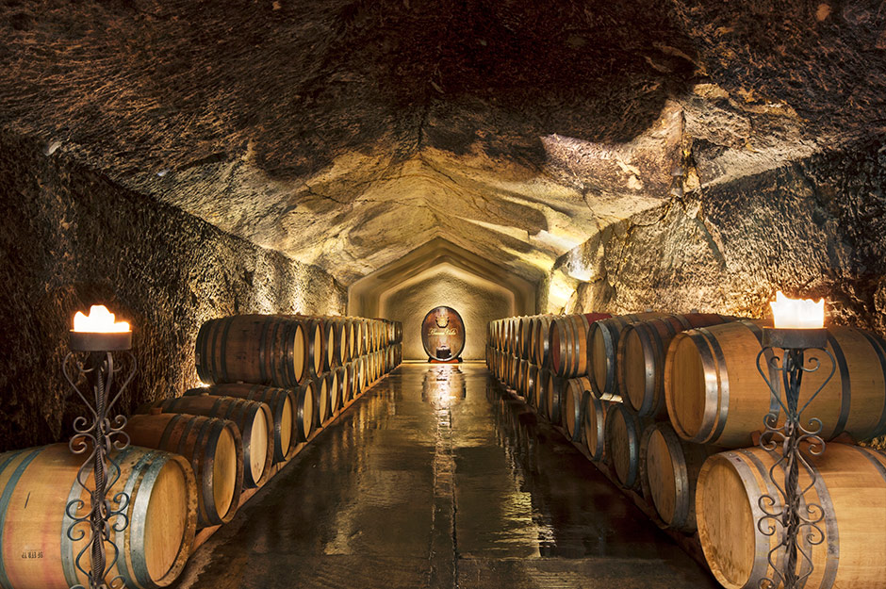
Wines from around the world
Motivation & Summary
Questions & Data
Data Cleanup & Exploration
Data Analysis
Discussion
Post Mortem
Questions

Slide 3


Motivation & Summary
Our project is to uncover new insights within the wine industry by analyzing data from 130k wine reviews. This will allow us to examine different wines from all over the world where wine enthusiast ranked their favorite wines based on price, taste, variety, country/region, and winery.

Slide 4
Questions & Data
Which of the 8 common wines is the most popular?
Do expensive wines affect its rating?
Does the wine origin have an impact on its popularity?
Does the country where a wine is from shape the price?
How does variety affect wine popularity against price?

Slide 5
Data Cleanup & Exploration
We took data from 130k wine reviews and randomly selected 1k reviews from that data set to analyze. From there this allowed our team to pull specific data for answering our questions.
Sommelier point ratings range only from 80 to 100
When cleaning our data our team found that there are over 100 different varieties of wines; therefore, we decided to focus on just the 8 most common wines for simple understanding.

Slide 6
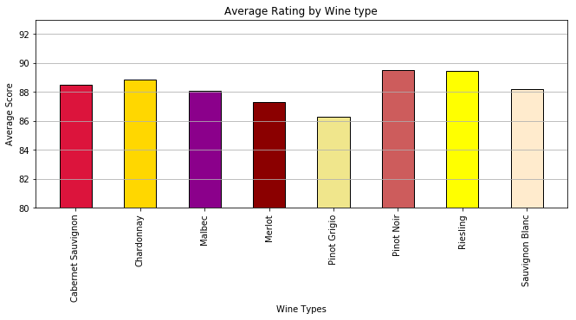
Data Analysis
Which of the 8 common wines is the most popular?

Slide 7
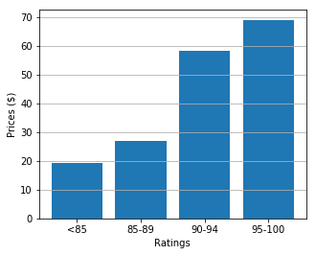
Data Analysis
Do expensive wines affect its rating?
Created incremental bins to find out the average Price for the Ratings levels.
The lower rated wines on average had lower prices than the higher rated wines.
The 90 and above rated wines on average cost double the wines rated 89 and below.

Slide 8
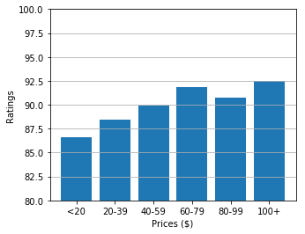
Data Analysis
Do expensive wines affect its rating?
Created incremental bins to find out the average Ratings levels for the Prices in $20 increments.
The lower priced wines on average had lower ratings than the higher priced wines.
According to the findings, price does not have an affect on ratings past $60-$79

Slide 9
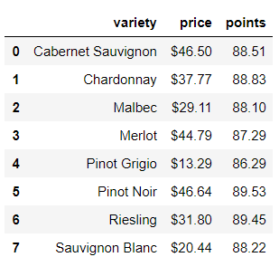
Data Analysis
How does variety affect wine popularity against price?
Grouped 8 common varieties of wines together
Found the average price and points for each variety of wine
Merged wines, price, and points together

Slide 10
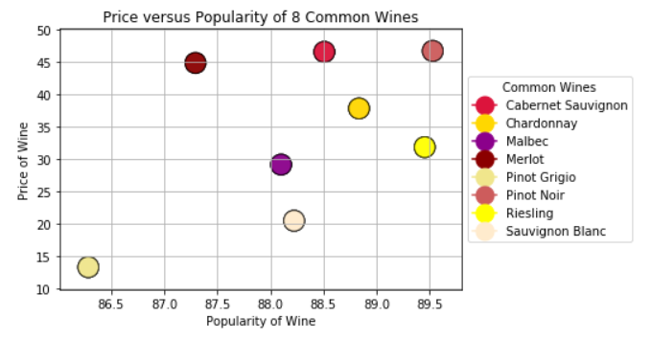
Data Analysis
How does variety affect wine popularity against price?
Pinot Noir is the most popular and expensive wine
Riesling is excellent versatile wine because of it's popularity and price
It appears that based off of the most 8 common wines popularity does seem to favor price

Slide 11
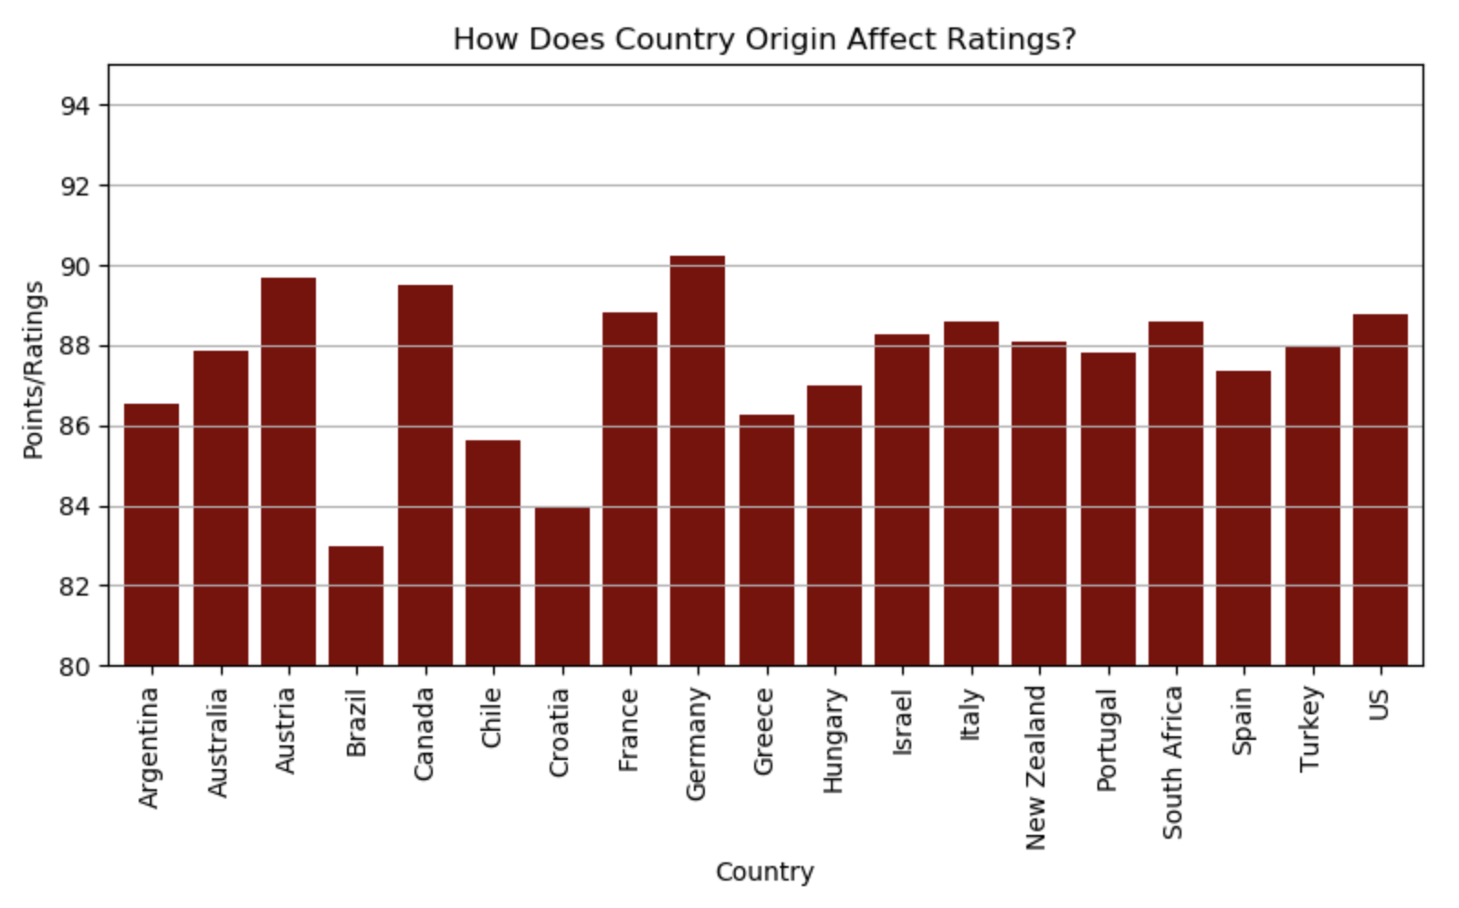
Data Analysis
Does the wine origin have an impact on its popularity?
Grouped the 19 countries and averaged the point ratings by the wine experts
Even with the US giving the most votes, Germany has the highest ranked wine at an average of 90.0
The worst ranked wine only falls at 83.0 points in Brazil, which overall isn't very low. The worst wines in the world aren't even ranked…only the best, so let's say Brazil has the worst best wine?

Slide 12
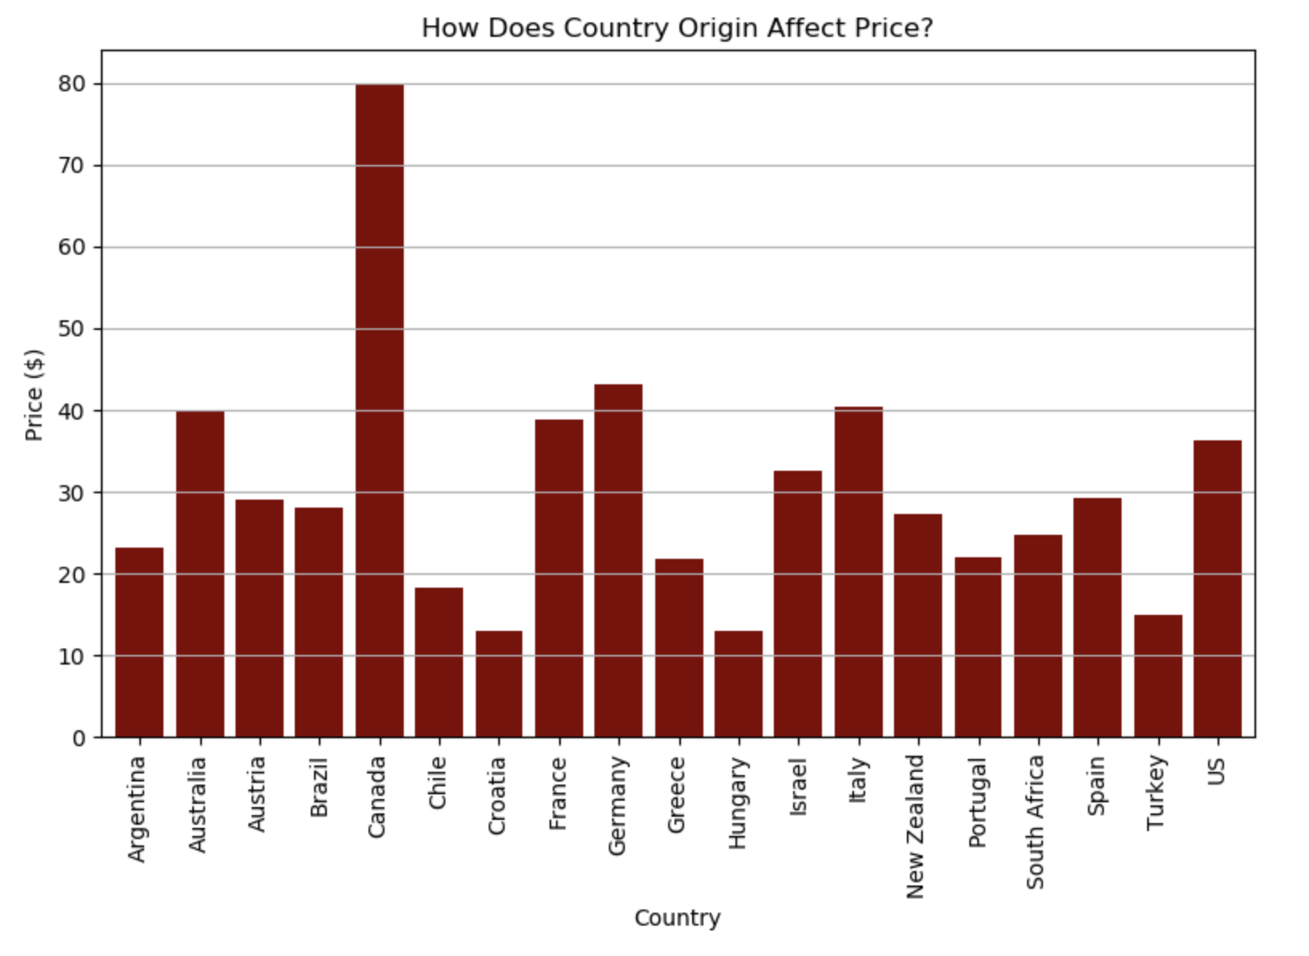
Data Analysis
Does the country where a wine is from shape the price?
Grouped by country and averaged the price of each wine rated by wine experts
Surprisingly, Canada has the highest priced wine at $80.00 and didn't fall that far behind the highest ranked Germany(90.0) in points with 89.5
That also means that the wines might be harder to come by causing an inflated price by the imported country

Slide 13
Discussion
Which of the 8 common wines is the most popular?
Do expensive wines affect its rating?
Does the wine origin have an impact on its popularity?
Does the country where a wine is from shape the price?
How does variety affect wine popularity against price?

Slide 14
Post Mortem
Problems in Research
Git hub repository
Data Cleaning 150,000 entries
Future Research
Vintage Year in Title of Wine
Specific winery search (Region)(Best Rating)
Number of Wines Rated by Origin

Slide 15
Questions?

Slide 16

Cheers!

